Slide 1

SAP BTP ABAP on Cloud / RAP Training
DAY-17
Anubhav Oberoy
www.AnubhavTrainings.com
Follow excellence with sheer passion

Slide 2


DISCLAIMER
The training content and delivery of this presentation is confidential, and cannot be recorded, or copied and distributed to any third party, without the written consent of Anubhav Trainings

Slide 3

01
Unmanaged Scenario
02
Implement the CURD
03
Attachments
04
Implementing Attachments
Notes:
https://pixabay.com/photos/san-francisco-transamerica-pyramid-1633203/

Slide 4
ALP Analytic List Page
An Analytical List Page (ALP) is a SAP Fiori element that allows users to analyze data and take action on it. It's a key component of SAP Fiori embedded analytics.
Here are some things you can do with an ALP:
Analyze data: Use KPIs, charts, tables, and visual filters to analyze data from different perspectives
Investigate root causes: Drill down to find root causes
Act on transactional content: Take action on transactional content
Build apps: Create apps that visualize and report data
Combine data: Combine transactional and analytical data using charts and tables
ALPs have a flexible layout that can be customized in a number of ways, including:
Sorting: Sort the work list
Page layout: Set page layout preferences
Filters: Set filters and save filter selections
Default views: Set default views
ALPs are organized into two sections: a header section for setting filters, and a content section for displaying charts and lists.
www.anubhavtrainings.com

Slide 5
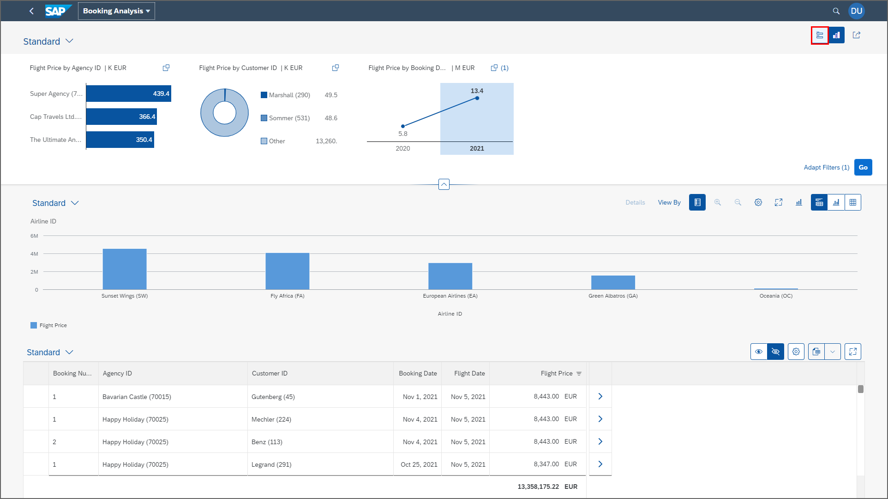
ALP
www.anubhavtrainings.com

Slide 6
Booking Consumption Analytics View
Booking Analytics CDS entity
Travel Analytics CDS entity
Carrier
Connection
/dmo/travel
/dmo/customer
/dmo/agency
Bookings

Slide 7
OVP – Overview pages
The Overview Page (OVP) in SAP is a data-driven app that provides users with a single page of information based on their role or domain. It helps users focus on important tasks by allowing them to quickly view, filter, and react to information.
Here are some things to know about the OVP:
Structure
The OVP has a header area and a content area. The content area displays cards that can contain charts, lists, tables, or text.
Cards
The OVP supports both standard and custom cards. Standard cards are entry-level views of the most relevant app data for a given topic or issue. Custom cards allow you to define the appearance and content of a card.
List cards
The OVP supports three types of list cards: list card, bar chart list card, and link list card.
Flavors
List cards can have two types of flavors: standard and bar. Standard flavor cards display items as numbers and text, while bar flavor cards display items as a combination of numbers, text, and a bar.
www.anubhavtrainings.com

Slide 8
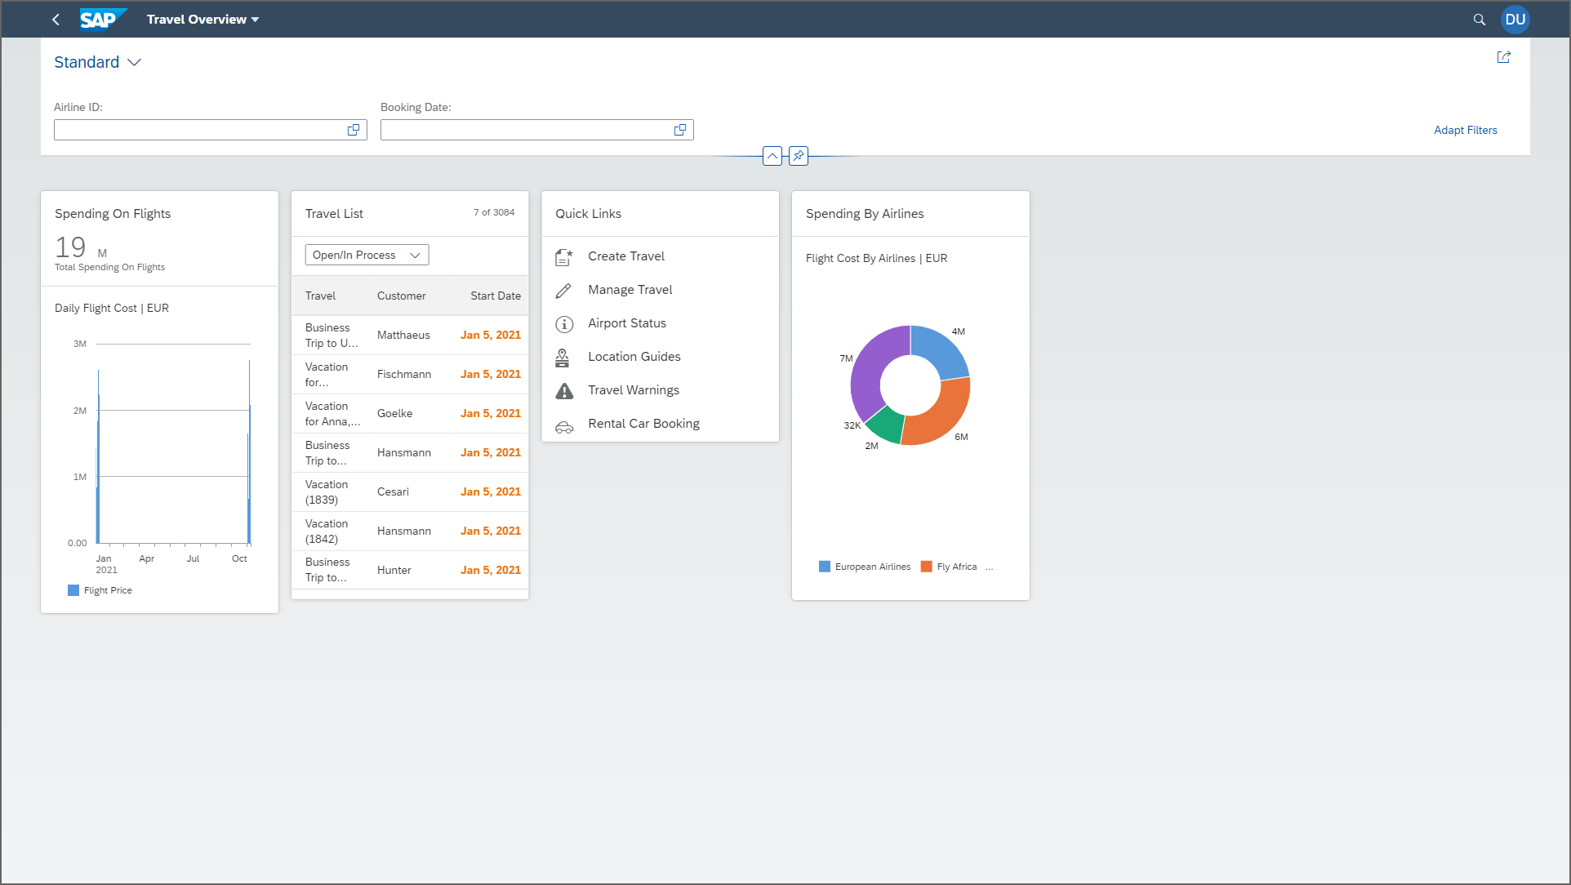
OVP
www.anubhavtrainings.com

Slide 9
Booking Consumption Analytics View
Booking Analytics CDS entity
Travel Analytics CDS entity
Carrier
Connection
/dmo/travel
/dmo/customer
/dmo/agency
Bookings

Slide 10
OVP – Overview pages
The Overview Page (OVP) in SAP is a data-driven app that provides users with a single page of information based on their role or domain. It helps users focus on important tasks by allowing them to quickly view, filter, and react to information.
Here are some things to know about the OVP:
Structure
The OVP has a header area and a content area. The content area displays cards that can contain charts, lists, tables, or text.
Cards
The OVP supports both standard and custom cards. Standard cards are entry-level views of the most relevant app data for a given topic or issue. Custom cards allow you to define the appearance and content of a card.
List cards
The OVP supports three types of list cards: list card, bar chart list card, and link list card.
Flavors
List cards can have two types of flavors: standard and bar. Standard flavor cards display items as numbers and text, while bar flavor cards display items as a combination of numbers, text, and a bar.
www.anubhavtrainings.com

Slide 11

OVP
www.anubhavtrainings.com

Slide 12
Reference Scenario – Unmanaged Impl.
Imagine in our company we had written all the business logic in the past ourself in form of FM, Classes. Today we want to reuse our old code which has the business logic, validation, sequence, processing, along with transaction buffer. So if you want to manage all these codes yourself and integrate your legacy (old code written by you or your team), you will opt for unmanaged (here RAP is not managing the CURD operation) scenario.
SAP is providing a demo class for learning purpose viz. /dmo/cl_flight_legacy
In this class we have our own old logic which contains the transaction buffer and business logic to maintain all the source code to interact with database ourself.
The RAP framework allows us to implement the entire runtime of the BO
Interaction Phase (code to interact and keep data inside itab)
Transaction Buffer (like a internal table where we keep temporary data)
Save Sequence (Commit work and Rollback)
UPDATE_BAPI
(LUW)
BAPI_TR_COMMIT
BAPI_TR_ROLLBACK
www.anubhavtrainings.com

Slide 13
Development Flow
Serv Impl.
BIMP-unmanaged
Serv definition
BDEF - unmanaged
Travel_U
Travel_U_MDE
Agency
Customer
agency
customer
/dmo/travel
www.anubhavtrainings.com

Slide 14
Title
<>
How you know in the code which fields are changed on the screen by the user.
So accordingly we can update the data into the database only for the changed fields??
RAP provides a compiler structure called %control which will tell us what fields were changed on UI.
We need to tell the RAP, what will be the datatype for the control structure.
*
*
*
www.anubhavtrainings.com

Slide 15
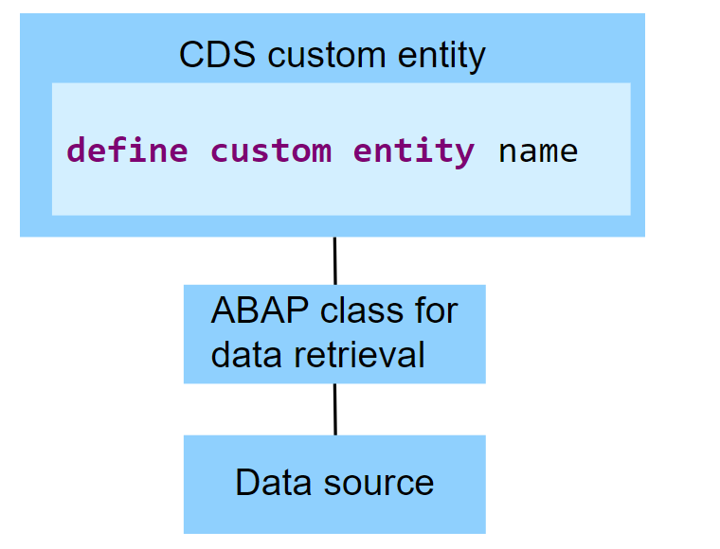
Custom Entities
A CDS custom entity allows developers to implement their own data retrieval using ABAP. A CDS custom entity is linked with an ABAP class and the data retrieval is executed on the application server. At the CDS level, only an interface is defined. Custom entities are used when data can't be accessed using SQL and the available CDS feature set.
The following image exemplifies the runtime of a CDS custom entity. It shows that the data retrieval is implemented by an ABAP class and the data source does not have to be a database table.
www.anubhavtrainings.com

Slide 16
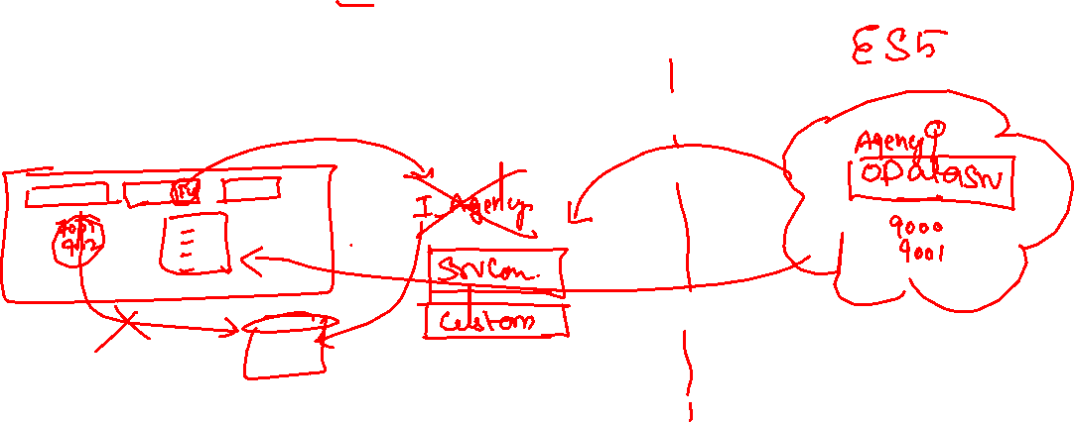
Reference Scenario – Custom Entity
In this exercise, we want to replace the travel agencies data of our managed travel app with the results of the remote OData service that provides different set of travel agencies from other system altogether. For this use case, we shall leverage the concept of a custom entity. In contrast to "normal" CDS views that read data from the database tables or other CDS views, the so-called custom entities act as a wrapper for a code-based implementation that provides the data instead. This use case involves following steps.
Creating the Service Consumption Model
Defining the Custom CDS Entity
Create a class that implements the query for the custom entity
Integrate the custom entity in MDE
www.anubhavtrainings.com

Slide 17










Slide 18
Reference Scenario – Unmanaged Impl.
Imagine in our company we had written all the business logic in the past ourself in form of FM, Classes. Today we want to reuse our old code which has the business logic, validation, sequence, processing, along with transaction buffer. So if you want to manage all these codes yourself and integrate your legacy (old code written by you or your team), you will opt for unmanaged (here RAP is not managing the CURD operation) scenario.
SAP is providing a demo class for learning purpose viz. /dmo/cl_flight_legacy
In this class we have our own old logic which contains the transaction buffer and business logic to maintain all the source code to interact with database ourself.
The RAP framework allows us to implement the entire runtime of the BO
Interaction Phase (code to interact and keep data inside itab)
Transaction Buffer (like a internal table where we keep temporary data)
Save Sequence (Commit work and Rollback)
UPDATE_BAPI
(LUW)
BAPI_TR_COMMIT
BAPI_TR_ROLLBACK
www.anubhavtrainings.com

Slide 19
Development Flow
Serv Impl.
BIMP-unmanaged
Serv definition
BDEF - unmanaged
Travel_U
Travel_U_MDE
Agency
Customer
agency
customer
/dmo/travel
www.anubhavtrainings.com

Slide 20
Title
<>
How you know in the code which fields are changed on the screen by the user.
So accordingly we can update the data into the database only for the changed fields??
RAP provides a compiler structure called %control which will tell us what fields were changed on UI.
We need to tell the RAP, what will be the datatype for the control structure.
*
*
*
www.anubhavtrainings.com

Slide 21
Reference Scenario – Unmanaged Impl.
Imagine in our company we had written all the business logic in the past ourself in form of FM, Classes. Today we want to reuse our old code which has the business logic, validation, sequence, processing, along with transaction buffer. So if you want to manage all these codes yourself and integrate your legacy (old code written by you or your team), you will opt for unmanaged (here RAP is not managing the CURD operation) scenario.
SAP is providing a demo class for learning purpose viz. /dmo/cl_flight_legacy
In this class we have our own old logic which contains the transaction buffer and business logic to maintain all the source code to interact with database ourself.
The RAP framework allows us to implement the entire runtime of the BO
Interaction Phase (code to interact and keep data inside itab)
Transaction Buffer (like a internal table where we keep temporary data)
Save Sequence (Commit work and Rollback)
UPDATE_BAPI
(LUW)
BAPI_TR_COMMIT
BAPI_TR_ROLLBACK
www.anubhavtrainings.com

Slide 22
Development Flow
Serv Impl.
BIMP-unmanaged
Serv definition
BDEF - unmanaged
Travel_U
Travel_U_MDE
Agency
Customer
agency
customer
/dmo/travel
www.anubhavtrainings.com

Slide 23
Title
<>
How you know in the code which fields are changed on the screen by the user.
So accordingly we can update the data into the database only for the changed fields??
RAP provides a compiler structure called %control which will tell us what fields were changed on UI.
We need to tell the RAP, what will be the datatype for the control structure.
*
*
*
www.anubhavtrainings.com

Slide 24
Attachments
Starring SAP ABAP on Cloud release 2208 SAP started direct support for attachments (PDF, Excel, Images, TXT, Word) including binary files. We must need to create a database table with atleast following columns
Attachment (Data type: RAWSTRING length 0)
Mimetype (Document type, String128)
Filename (Document Name, String128)
Travel
Attachments
1 n
www.anubhavtrainings.com

Slide 25
Steps
Create new attachment table according to need and design
Create a Interface Entity for the attachment table and mark our attachment field with special attachment annotation, So the RAP framework can treat it as an attachment accordingly.
Add annotations for admin fields, and user labels.
Create composition of our attachment table with travel entity like we had the composition of booking with travel entity.
Create a projection view for attachment
Relationship between Travel processor view with attachment processor view entity
Enhance the BDEF with attachment like booking
Also expose the attachment functionality with draft to processor in behavior projection for processor
Expose the entity of attachment processor in service definition
Republish the OData V4 binding
Add the metadata extension for attachment scenario and link a new facet in travel for attachment table
Testing
www.anubhavtrainings.com

Slide 26
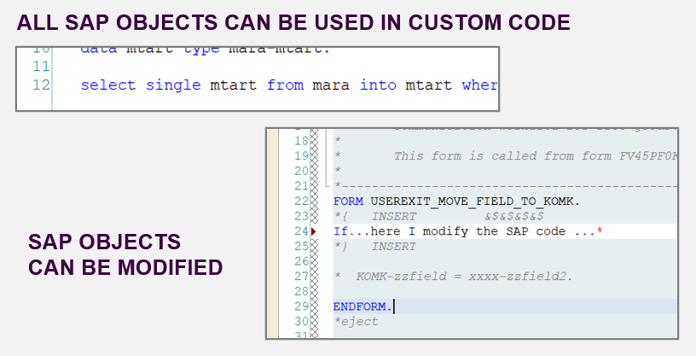
From classic ABAP extensions to ABAP Cloud development
<>
www.anubhavtrainings.com

Slide 27
What is ABAP Cloud Development Means:
Use public SAP APIs (local or remote) released by SAP to access SAP functionality and SAP data
Use public SAP extension points released by SAP to extend SAP objects. Modifications to SAP standard objects are not supported (applies to S/4HANA Cloud system)
Use of Adt (ABAP development tools) on eclipse
Use Steampunk (RAP – Restful Application Programming model) to build Fiori Applications and services. SAP technologies like Dynpro and webdynpro are not released for cloud development.
www.anubhavtrainings.com

Slide 28
What is Embedded Steampunk
If we are using SAP BTP to develop side by side extensions, full stack SAP applications in BTP (Steampunk)
If we are using In-app Developer extensibility with released objects in S/4HANA (all editions) with RAP (Embedded Steampunk)
If you using RAP and enhancing your Standard SAP Applications delivered by SAP in S/4HANA system, the recommended approach is Embedded Steampunk.
Every Customer using S/4HANA can decide whether they want to use new approach (embedded Steampunk) or classic extension approach (BADI) @ Object level
This can be done by switching a setting @ object level.
www.anubhavtrainings.com

Slide 29
www.anubhavtrainings.com
Thank You
End of Day 17
www.anubhavtrainings.com

Slide 30


We’re committed to empower you to be
#FutureReady
through powerful training solutions.
We build the workforce of the future.
250+
Corporate Clients
30,000+
Learners Trained
25000+
Learners Placed
FREE WEBINARS
Sign up for free webinars with industry experts every fortnight!
Enroll Now!
Contact us today!
https://anubhavtrainings.com

